Slide 1
Deﬁnition A random variable X is said to be continuous if it can assume any value in a given interval. This contrasts with the deﬁnition of a discrete random variable which can only assume discrete values

Slide 2
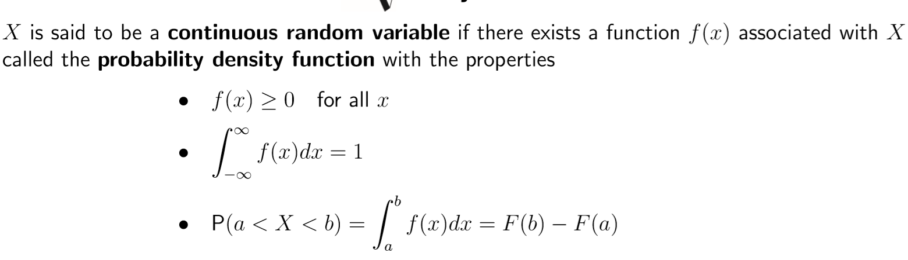

Slide 3
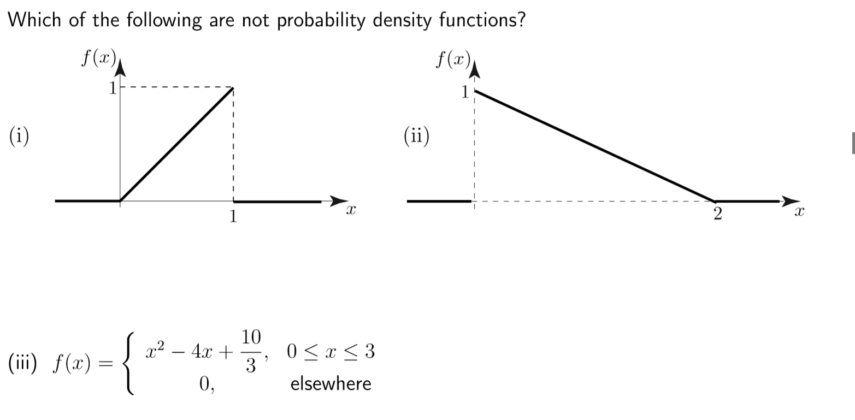

Slide 4
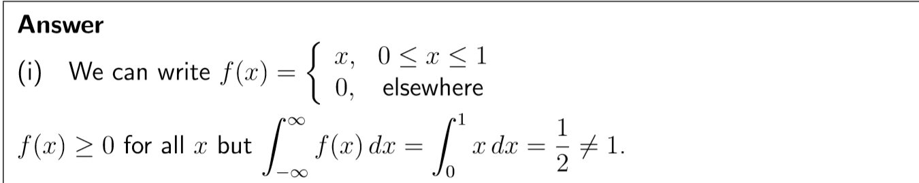
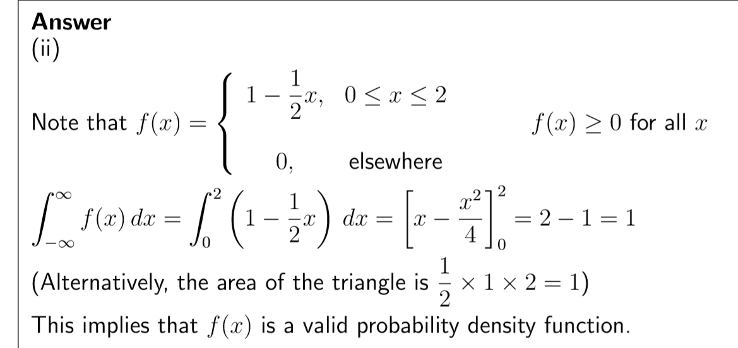

Slide 5
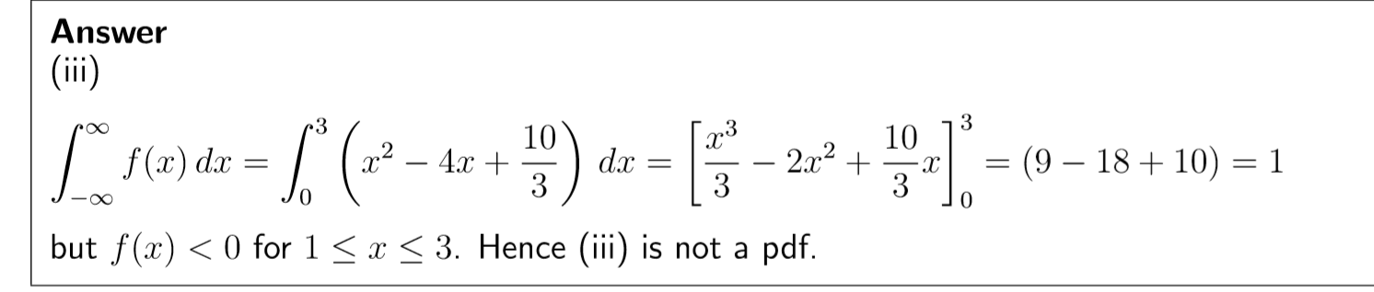

Slide 6
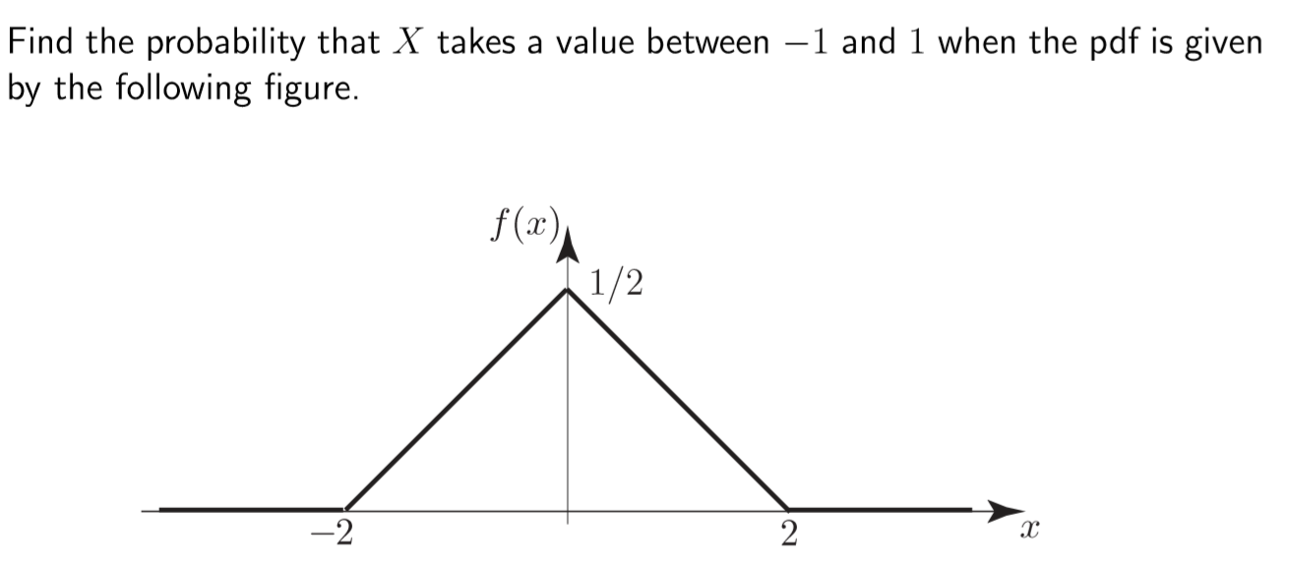
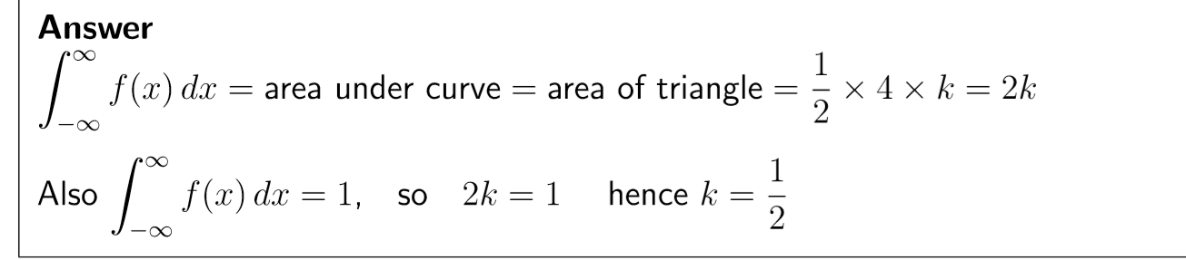

Slide 7
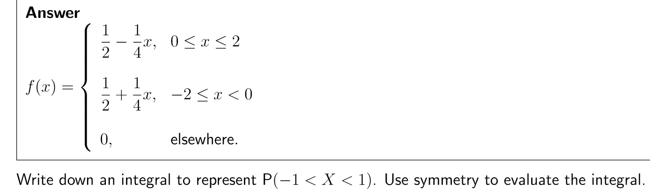
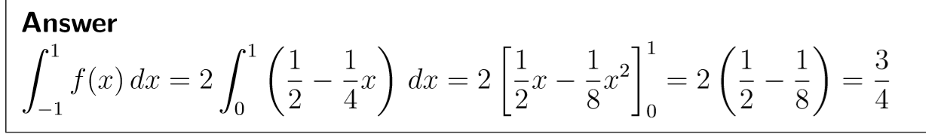

Slide 8
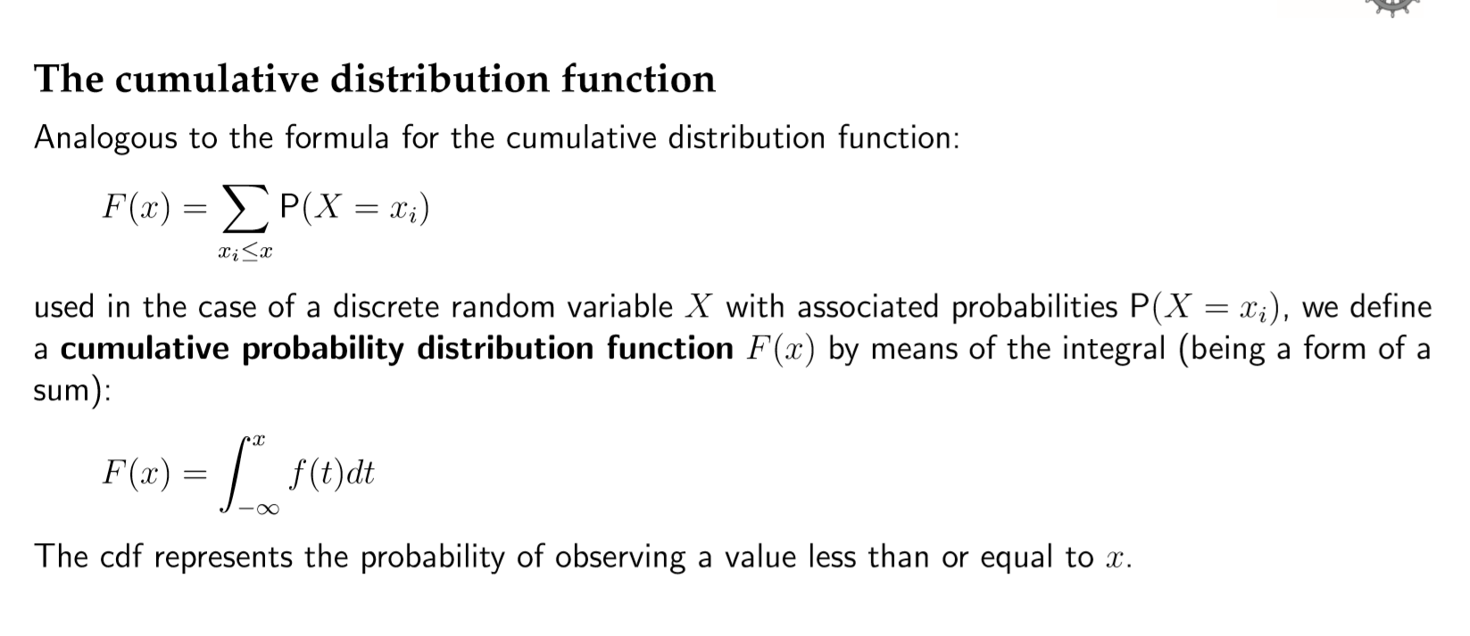

Slide 9
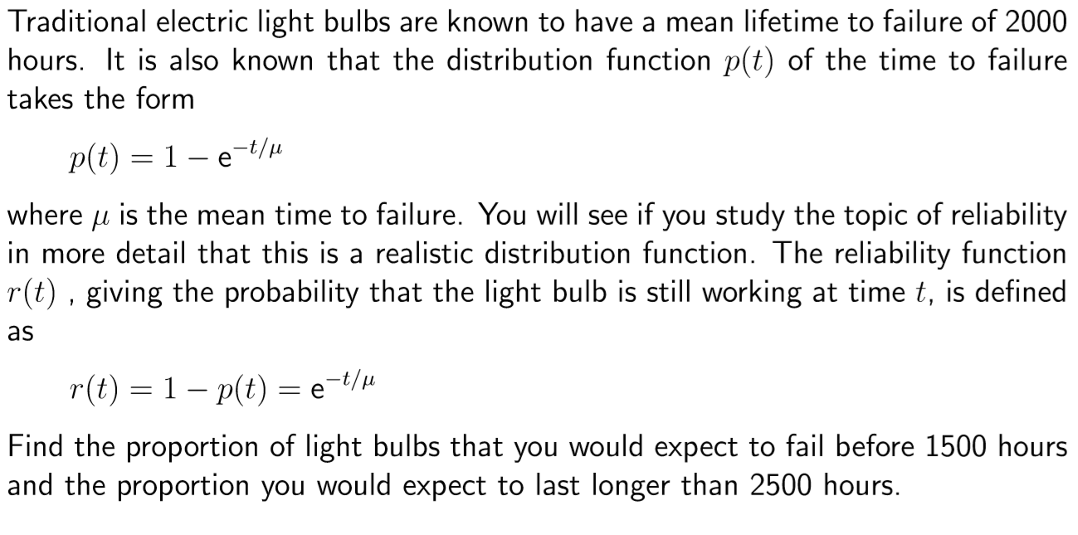

Slide 10
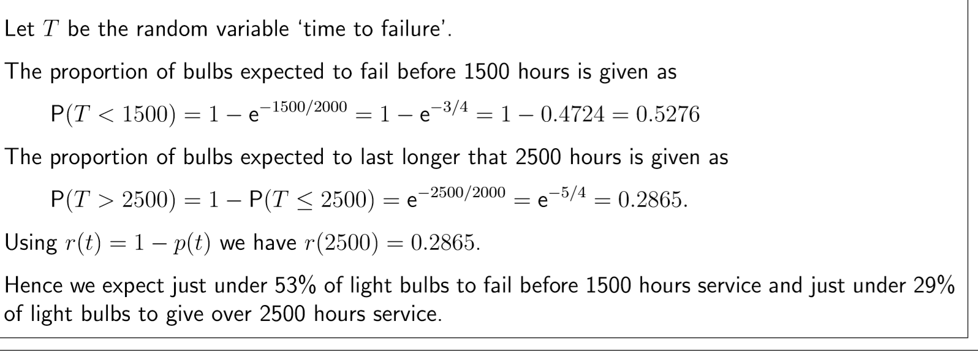

Slide 11
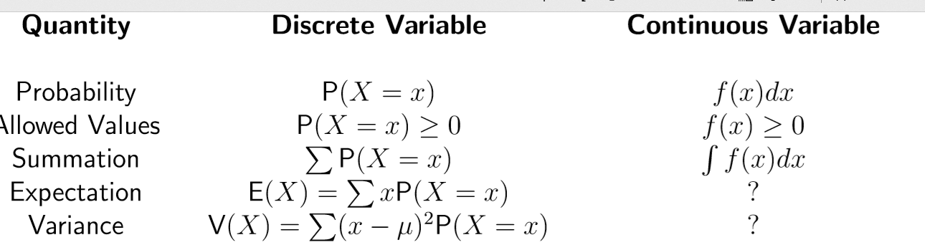

Slide 12
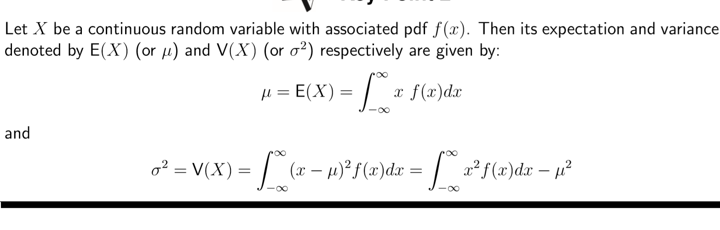

Slide 13
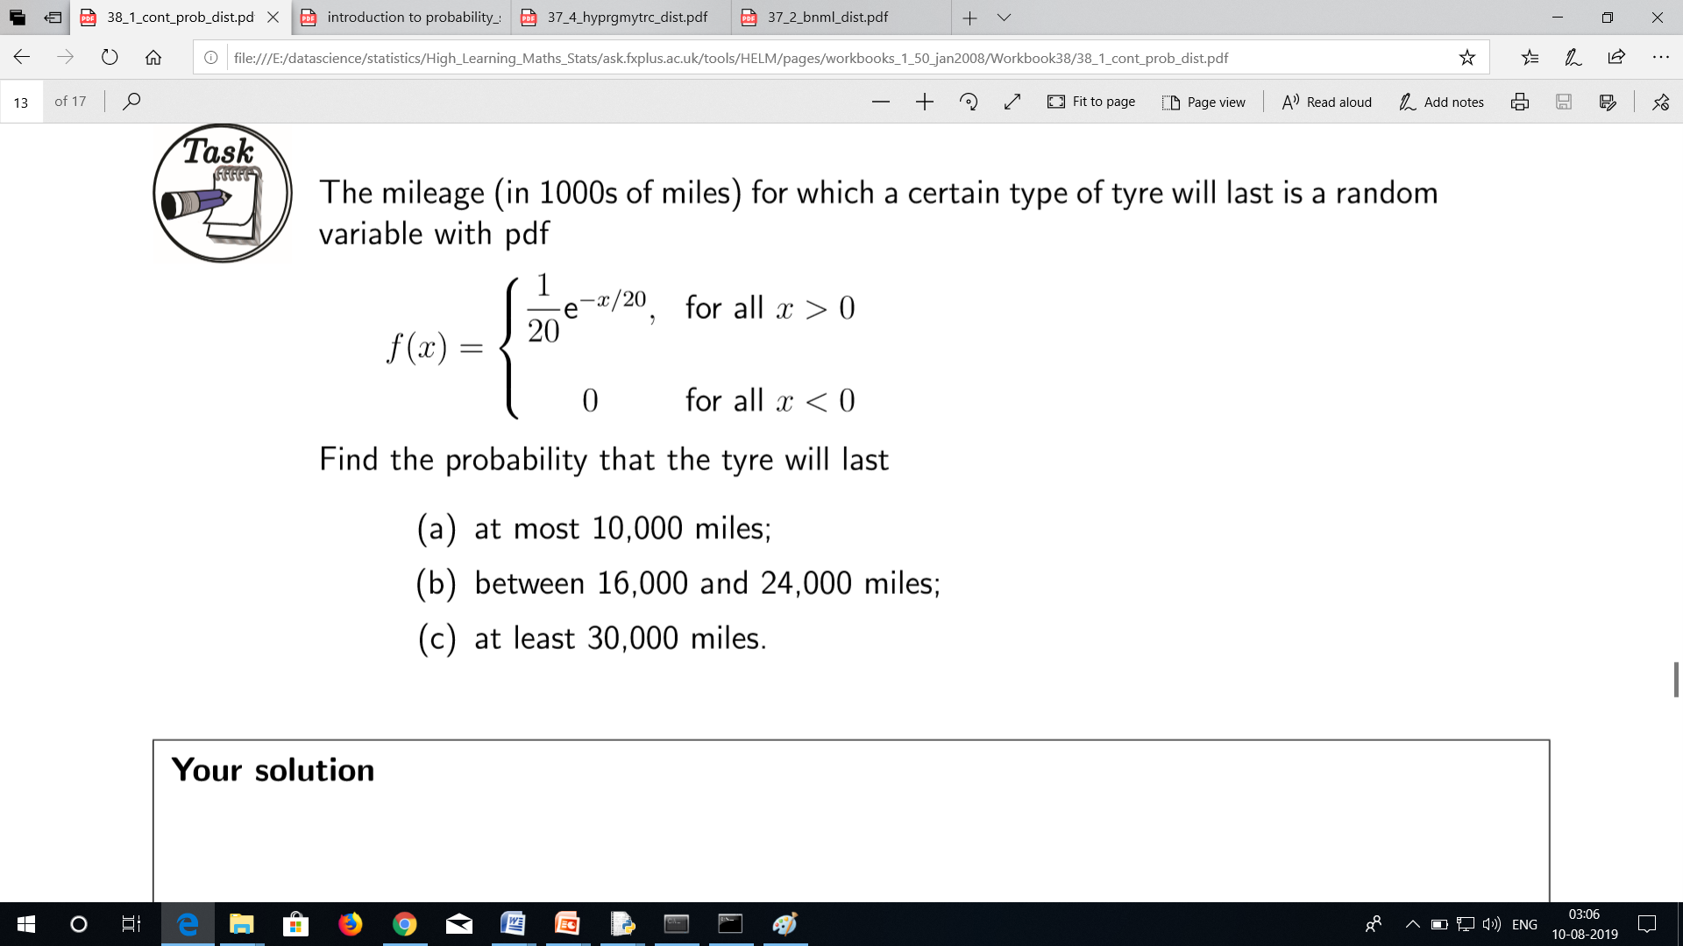

Slide 14
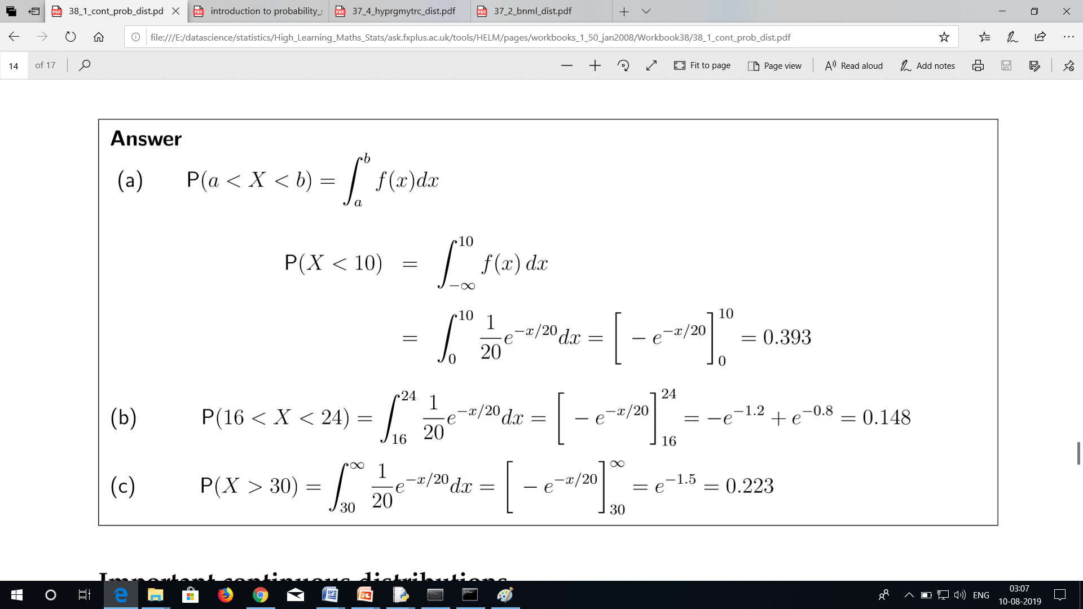

Slide 15
Normal Distribution

Slide 16
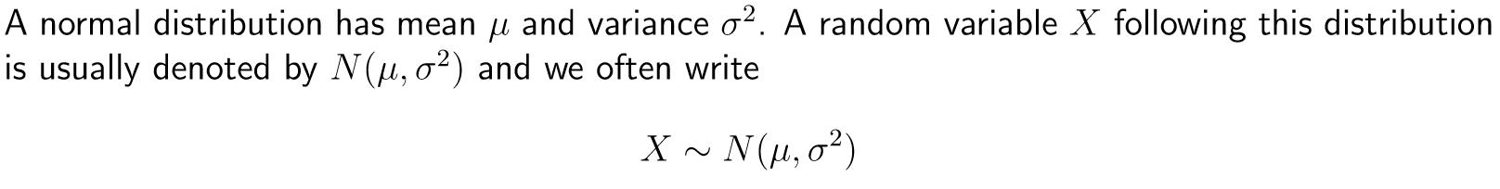

Slide 17
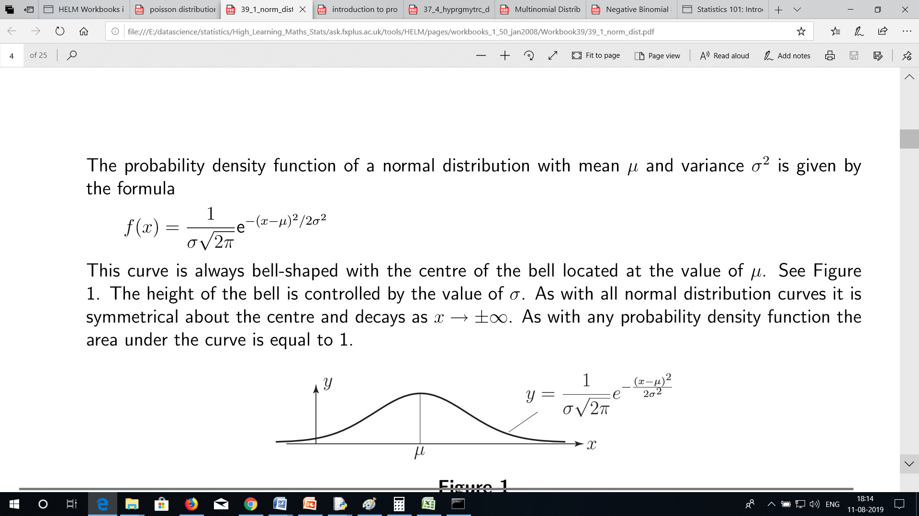

Slide 18
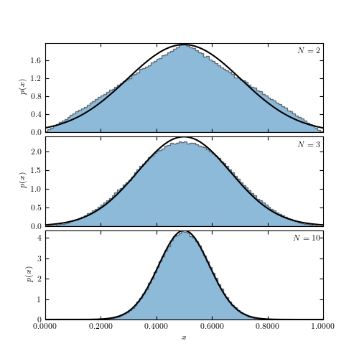

Slide 19
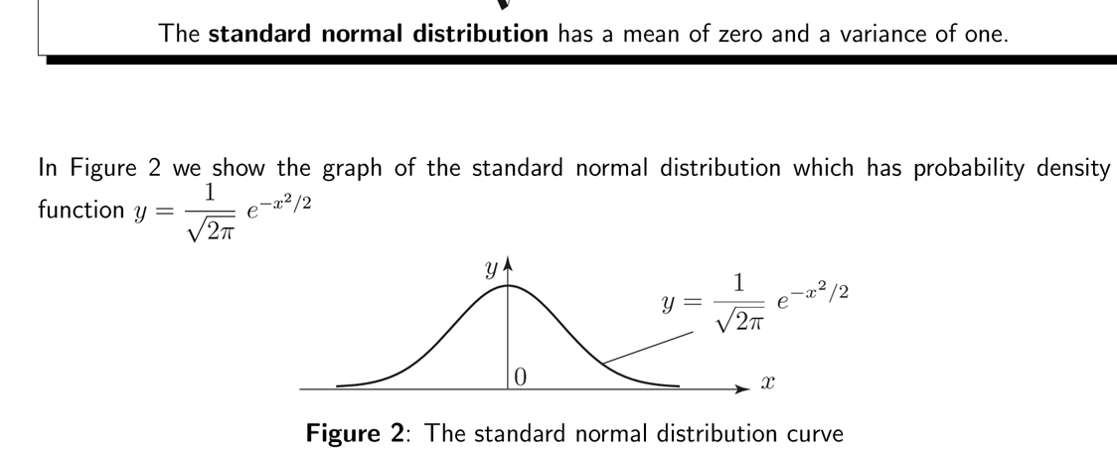

Slide 20
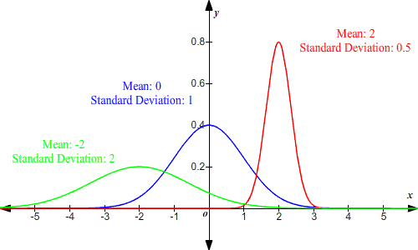

Slide 21
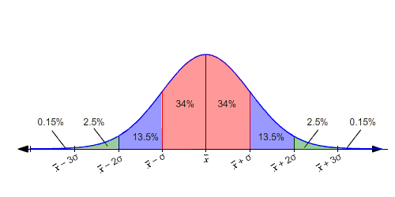

Slide 22
That is, if x¯ is the mean and σ is the standard deviation of the distribution, then 68%
of the values fall in the range between (x¯−σ) and(x¯+σ).
About 95% of the values lie within two standard deviations of the mean, that is, between (x¯−2σ) and (x¯+2σ).
(In the figure, this is the sum of the pink and blue regions: 34%+34%+13.5%+13.5%=95%)
About 99.7% of the values lie within three standard deviations of the mean, that is, between (x¯−3σ) and (x¯+3σ).

Slide 23
Example 1:
A set of data is normally distributed with a mean of 5 What percent of the data is less than 5 ?
A normal distribution is symmetric about the mean. So, half of the data will be less than the mean and half of the data will be greater than the mean.
Therefore, 50% percent of the data is less than 5
Example 2:
The life of a fully-charged cell phone battery is normally distributed with a mean of 14 hours with a standard deviation of 11 hour. What is the probability that a battery lasts at least 13 hours?
The mean is 14 and the standard deviation is 11 .
50% of the normal distribution lies to the right of the mean, so 50% of the time, the battery will last longer than 14 hours.
The interval from 13 to 14 hours represents one standard deviation to the left of the mean. So, about 34% of time, the battery will last between 13 and 14 hours.
Therefore, the probability that the battery lasts at least 13 hours is about 34%+50% or 0.84

Slide 24
The average weight of a raspberry is 4.4 gm with a standard deviation of 1.3 gm.
What is the probability that a randomly selected raspberry would weigh at least 3.1 gm
but not more than 7.0 gm?
The mean is 4.4 and the standard deviation is 1.31.
4.4−1.3=3.1
and
4.4+2(1.3)=7.0
So, the interval 3.1≤x≤7.0 is actually between one standard deviation below the mean and
2 standard deviations above the mean.
In normally distributed data, about 34% of the values lie between the mean and one standard deviation below the mean, and
34% between the mean and one standard deviation above the mean.
In addition, 13.5% of the values lie between the first and second above the mean.
Adding the areas, we get 34%+34%+13.5%=81.5%.
Therefore, the probability that a randomly selected raspberry will weigh at least 3.1 gm but not more than 7.0 gm is 81.5% or 0.815 .

Slide 25
X is a normally normally distributed variable with mean μ = 30 and standard deviation σ = 4. Find a) P(x < 40) b) P(x > 21) c) P(30 < x < 35)
Note: What is meant here by area is the area under the standard normal curve. a) For x = 40, the z-value z = (40 - 30) / 4 = 2.5 Hence P(x < 40) = P(z < 2.5) = [area to the left of 2.5] = 0.9938
b) For x = 21, z = (21 - 30) / 4 = -2.25 Hence P(x > 21) = P(z > -2.25) = [total area] - [area to the left of -2.25] = 0.9878
c) For x = 30 , z = (30 - 30) / 4 = 0 and for x = 35, z = (35 - 30) / 4 = 1.25 Hence P(30 < x < 35) = P(0 < z < 1.25) = [area to the left of z = 1.25] - [area to the left of 0] = 0.8944 - 0.5 = 0.3944

Slide 26
A radar unit is used to measure speeds of cars on a motorway. The speeds are normally distributed with a mean of 90 km/hr and a standard deviation of 10 km/hr. What is the probability that a car picked at random is travelling at more than 100 km/hr?
Let x be the random variable that represents the speed of cars. x has μ = 90 and σ = 10. We have to find the probability that x is higher than 100 or P(x > 100) For x = 100 , z = (100 - 90) / 10 = 1 P(x > 100) = P(z > 1) = [total area] - [area to the left of z = 1] = 1 - 0.8413 = 0.1587 The probability that a car selected at a random has a speed greater than 100 km/hr is equal to 0.1587

Slide 27
Normal Cumulative Distribution

Slide 28
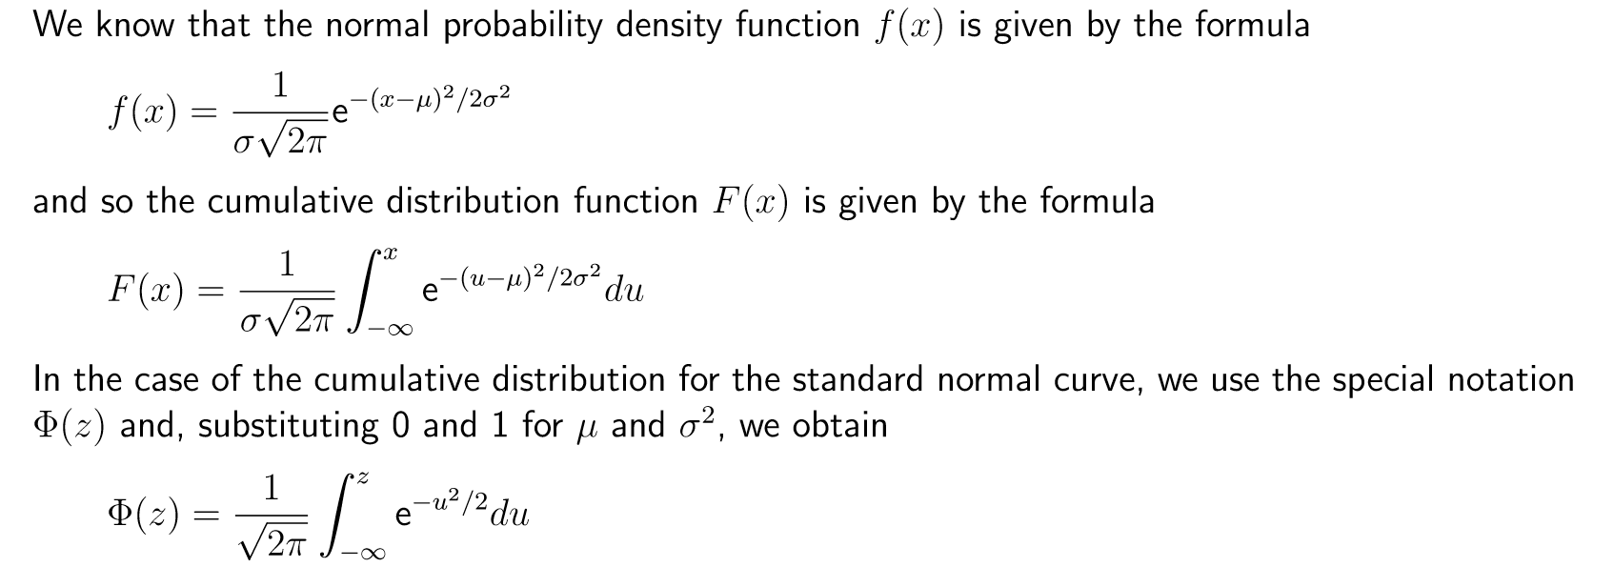

Slide 29
Gamma Distribution Function

Slide 30
Gamma Function

Slide 31
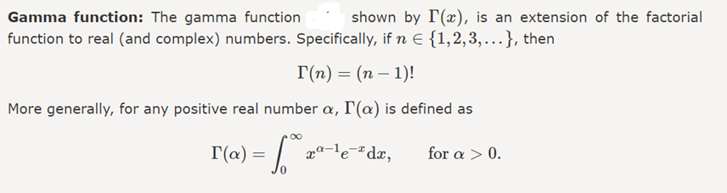

Slide 32
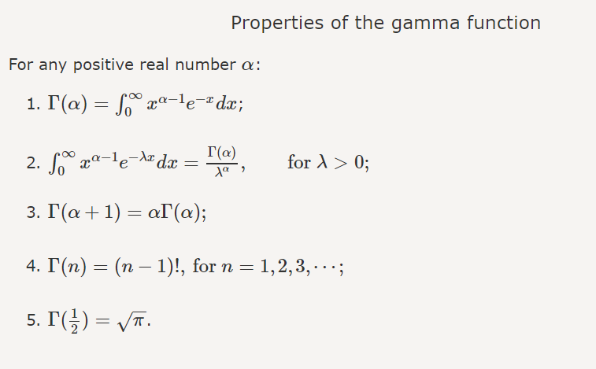

Slide 33
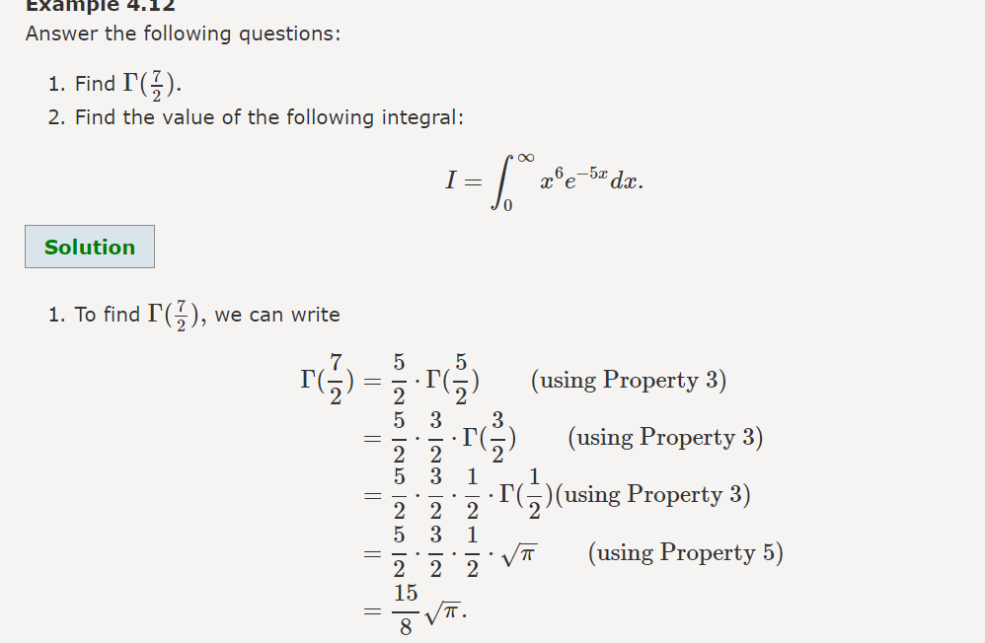

Slide 34
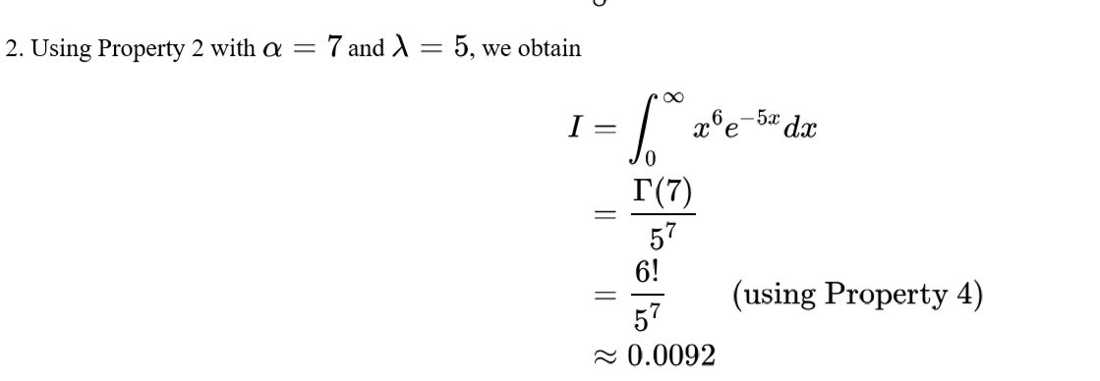

Slide 35
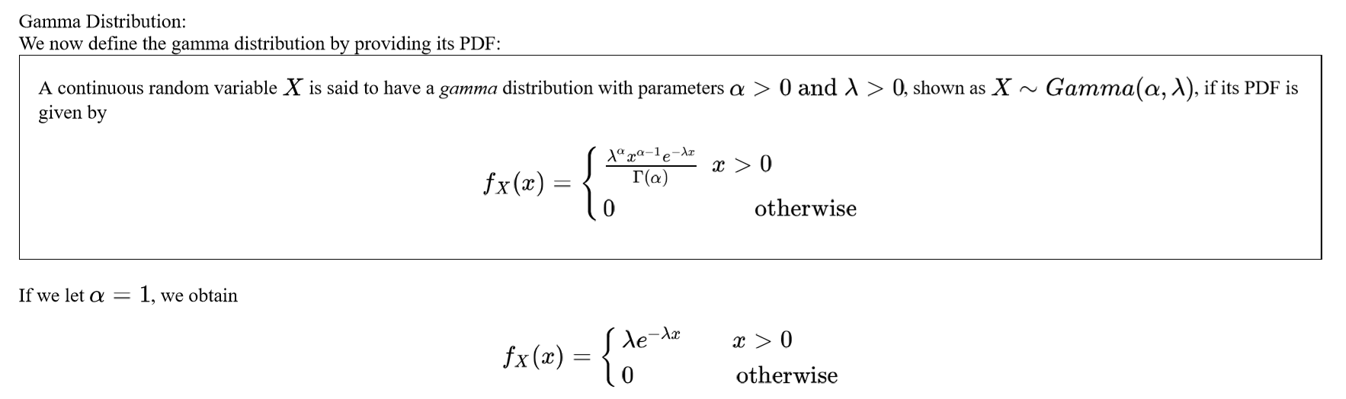

Slide 36
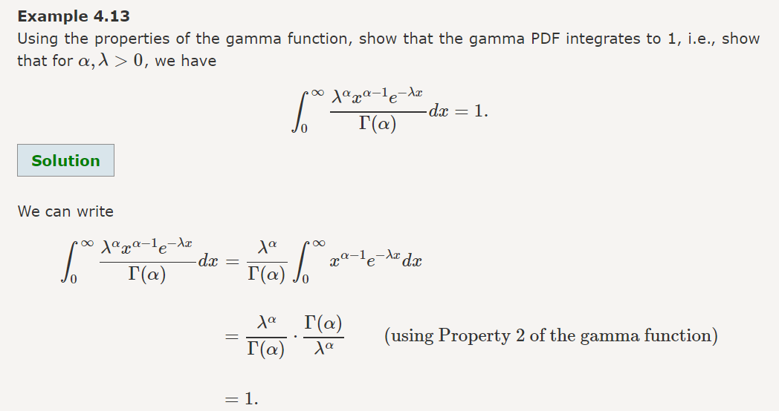

Slide 37
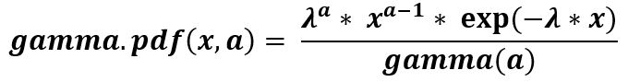
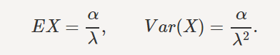
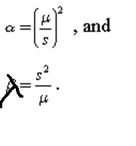
Mean and Variance of Gamma Distribution
a : shape parameters
The shape and scale parameters of a Gamma distribution can be calculated from its mean μ and standard deviation s according to the relationships:

Slide 38
Draw a careful sketch of the gamma probability density functions in each of the following cases:
0< alpha <1.
k=1
k >1.

Slide 39
Application
The gamma distribution has been used to model the size of insurance claims and rainfalls.^{[21]} This means that aggregate insurance claims and the amount of rainfall accumulated in a reservoir are modelled by a gamma process
In wireless communication, the gamma distribution is use to model the multi-path fading of signal power;
In oncology, the age distribution of cancer incidence often follows the gamma distribution, whereas the shape and scale parameters predict, respectively, the number of driver events and the time interval between them .

Slide 40
Beta Distribution

Slide 41
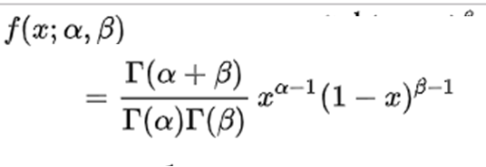
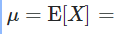
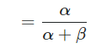
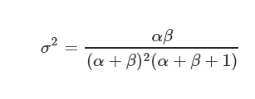
The probability density function (pdf) of the beta distribution, for 0 ≤ x ≤ 1, and shape parameters α, β > 0, is a power function of the variable x and of its reflection (1 − x) as follows:

Slide 42
Exponential Distribution

Slide 43
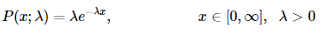
The exponential distribution represents a process in which events occur continuously and independently at a constant average rate.

Slide 44
Uniform Distribution

Slide 45
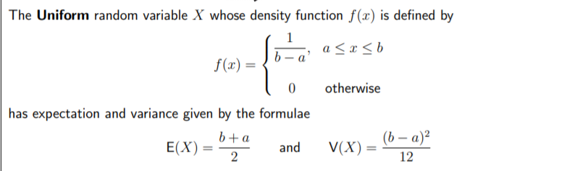

Slide 46
Bivariate Normal Distribution

Slide 47
A bivariate normal distribution is made up of two independent random variables. The two variables in a bivariate normal are both are normally distributed, and they have a normal distribution when both are added together. Visually, the bivariate normal distribution is a three-dimensional bell curve.
Some of the more common ways to characterize it include:
Random variables X & Y are bivariate normal if aX + bY has a normal distribution for all a,b∈R.
X and Y are jointly normal if they can be expressed as X = aU + bV, and Y = cU + dV (Bertsekas & Tsitsiklis, 2002)
If a and b are non-zero constants, aX + bY has a normal distribution (Johnson & Kotz, 1972).
If X – aY and Y are independent and if Y – bx and X are independent for all a,b (such that ab ≠ 0 or 1), then (X,Y) has a normal distribution (Rao, 1975).

Slide 48
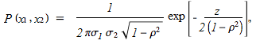
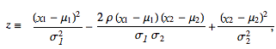
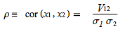
The bivariate normal distribution can be defined as the probability density function (PDF) of two variables X and Y that are linear functions of the same independent normal random variables (adapted from Wolfram):

Slide 49
Skewness and Kurtosis

Slide 50
A fundamental task in many statistical analyses is to characterize the location and variability of a data set.
A further characterization of the data includes skewness and kurtosis.
Skewness is a measure of symmetry, or more precisely, the lack of symmetry. A distribution, or data set, is symmetric if it looks the same to the left and right of the center point.
The skewness for a normal distribution is zero, and any symmetric data should have a skewness near zero. Negative values for the skewness indicate data that are skewed left and positive values for the skewness indicate data that are skewed right. By skewed left, we mean that the left tail is long relative to the right tail. Similarly, skewed right means that the right tail is long relative to the left tail.
Kurtosis is a measure of whether the data are heavy-tailed or light-tailed relative to a normal distribution. That is, data sets with high kurtosis tend to have heavy tails, or outliers. Data sets with low kurtosis tend to have light tails, or lack of outliers
positive kurtosis indicates a "heavy-tailed" distribution and negative kurtosis indicates a "light tailed" distribution.

Slide 51
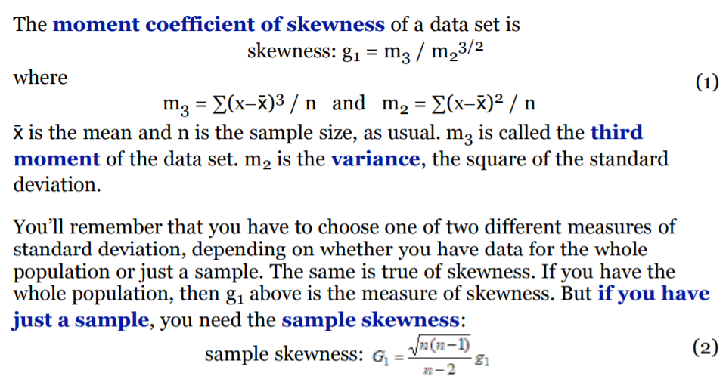
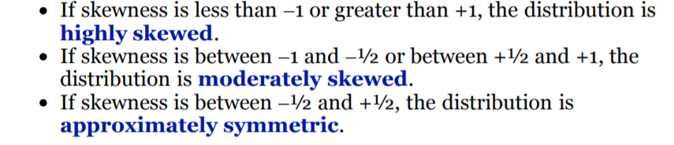

Slide 52
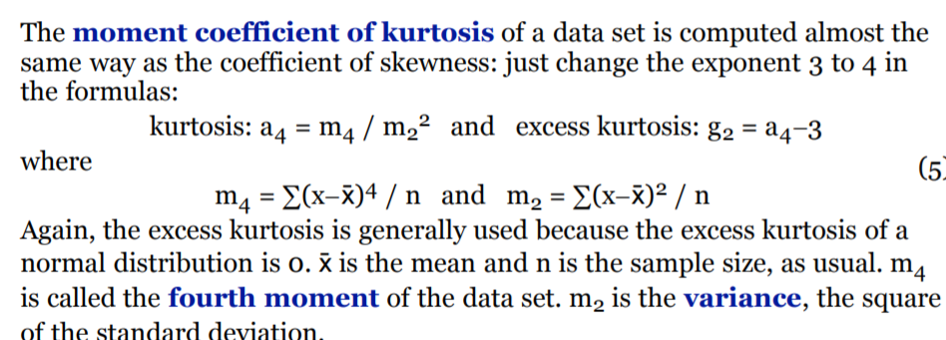

Slide 53
Multivariate Normal Distribution

Slide 54
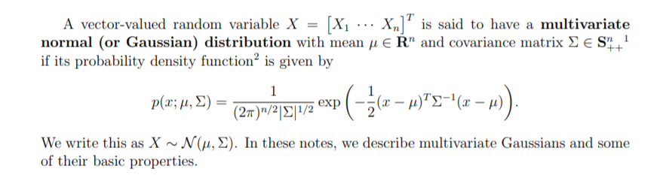

Slide 55
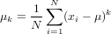
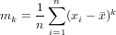
Central Moment
The k^{th} central moment (or moment about the mean) of a data population is:
Similarly, the k^{th} central moment of a data sample is:
In particular, the second central moment of a population is its variance.

Slide 56
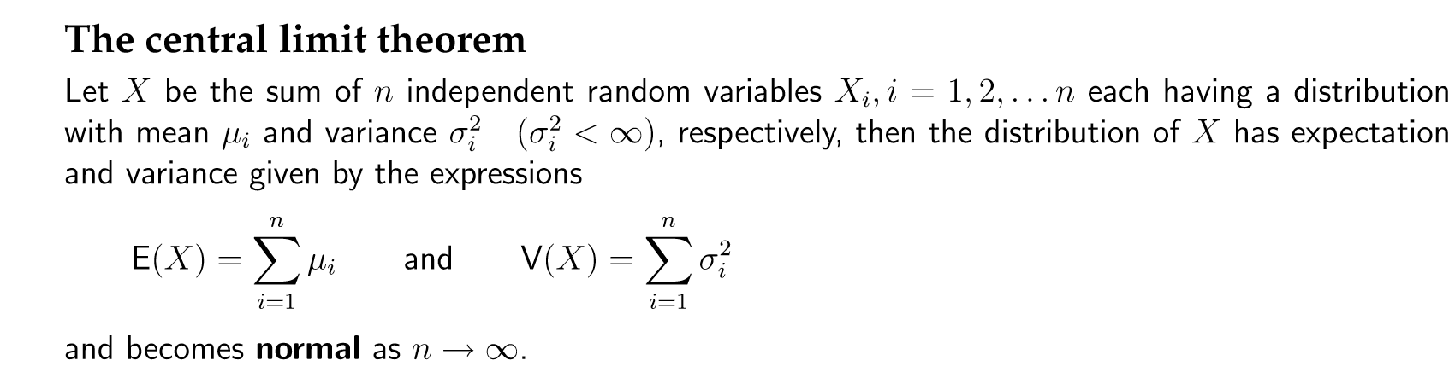

Slide 57
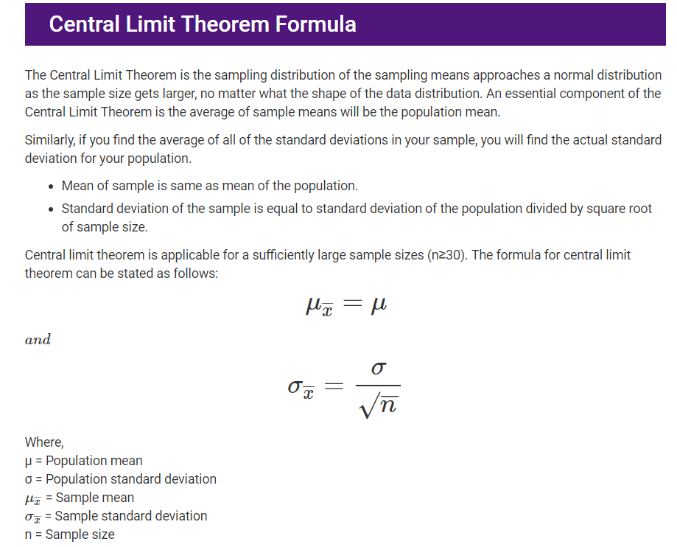

Slide 58
Law of Large numbers
The law of large numbers is a principle of probability according to which the frequencies of events with the same likelihood of occurrence even out, given enough trials or instances. As the number of experiments increases, the actual ratio of outcomes will converge on the theoretical, or expected, ratio of outcomes.

Slide 59
In probability theory, the law of large numbers (LLN) is a theorem that describes the result of performing the same experiment a large number of times. According to the law, the average of the results obtained from a large number of trials should be close to the expected value, and will tend to become closer as more trials are performed.
The LLN is important because it guarantees stable long-term results for the averages of some random events. For example, while a casino may lose money in a single spin of the roulette wheel, its earnings will tend towards a predictable percentage over a large number of spins. Any winning streak by a player will eventually be overcome by the parameters of the game. It is important to remember that the law only applies (as the name indicates) when a large number of observations is considered. There is no principle that a small number of observations will coincide with the expected value or that a streak of one value will immediately be "balanced" by the others (see the gambler's fallacy).

Slide 60
Bayes Theorem

Slide 61
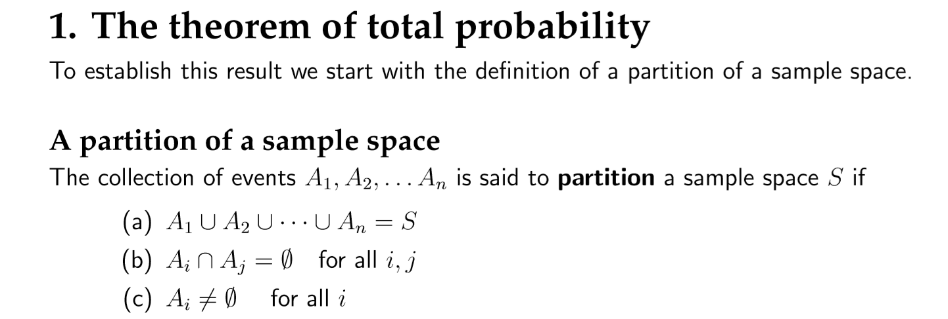

Slide 62


Slide 63


Slide 64


Slide 65

At a certain university, 4% of men are over 6 feet tall and 1% of women are over 6 feet tall. The total student population is divided in the ratio 3:2 in favour of women. If a student is selected at random from among all those over six feet tall, what is the probability that the student is a woman?

Slide 66
A factory production line is manufacturing bolts using three machines, A, B and C. Of the total output, machine A is responsible for 25%, machine B for 35% and machine C for the rest. It is known from previous experience with the machines that 5% of the output from machine A is defective, 4% from machine B and 2% from machine C. A bolt is chosen at random from the production line and found to be defective. What is the probability that it came from
(a) machine A (b) machine B (c) machine C?

Slide 67



Slide 68

A doctor assumes that a patient has one of three diseases d1, d2, ord3. Before any test, he assumes an equal probability for each disease. He carries out a test that will be positive with probability .8 if the patient has d1, .6 if he has disease d2, and .4 if he has disease d3. Given that the outcome of the test was positive, what probabilities should the doctor now assign to the three possible diseases?

Slide 69
What is Naive Bayes Classifier?
Naive Bayes is a statistical classification technique based on Bayes Theorem. It is one of the simplest supervised learning algorithms. Naive Bayes classifier is the fast, accurate and reliable algorithm. Naive Bayes classifiers have high accuracy and speed on large datasets.

Slide 70

Algorithm
Bayes theorem provides a way of calculating the posterior probability, P(c|x), from P(c), P(x), and P(x|c). Naive Bayes classifier assume that the effect of the value of a predictor (x) on a given class (c) is independent of the values of other predictors. This assumption is called class conditional independence.
P(c|x) is the posterior probability of class (target) given predictor (attribute).
P(c) is the prior probability of class.
P(x|c) is the likelihood which is the probability of predictor given class.
P(x) is the prior probability of predictor.

Slide 71


Slide 72


Slide 73


Slide 74


Slide 75


Slide 76


Slide 77
Naive Bayes with Multiple Labels
Till now you have learned Naive Bayes classification with binary labels. Now you will learn about multiple class classification in Naive Bayes. Which is known as multinomial Naive Bayes classification. For example, if you want to classify a news article about technology, entertainment, politics, or sports.
In model building part, you can use wine dataset which is a very famous multi-class classification problem. "This dataset is the result of a chemical analysis of wines grown in the same region in Italy but derived from three different cultivars." (UC Irvine)
Dataset comprises of 13 features (alcohol, malic_acid, ash, alcalinity_of_ash, magnesium, total_phenols, flavanoids, nonflavanoid_phenols, proanthocyanins, color_intensity, hue, od280/od315_of_diluted_wines, proline) and type of wine cultivar. This data has three type of wine Class_0, Class_1, and Class_2. Here you can build a model to classify the type of wine.

Slide 78


Slide 79


Income/No | Xi-Mean | (Xi-Mean)^2
125 | 15 | 225
100 | -10 | 100
70 | -40 | 1600
120 | 10 | 100
60 | -50 | 2500
220 | 110 | 12100
75 | -35 | 1225
110 |  | 17850
 |  | 2975

Slide 80


Slide 81
A hypothesis is an educated guess about something in the world around you. It should be testable, either by experiment or observation. For example:
A new medicine you think might work.
A way of teaching you think might be better.
A possible location of new species.
A fairer way to administer standardized tests.
It can really be anything at all as long as you can put it to the test.
What is a Hypothesis Statement?
If you are going to propose a hypothesis, it’s customary to write a statement.
Your statement will look like this: “If I…(do this to an independent variable)….then (this will happen to the dependent variable).” For example:
If I (decrease the amount of water given to herbs) then (the herbs will increase in size).
If I (give patients counseling in addition to medication) then (their overall depression scale will decrease).
If I (give exams at noon instead of 7) then (student test scores will improve).
If I (look in this certain location) then (I am more likely to find new species).
A good hypothesis statement should:
Include an “if” and “then” statement (according to the University of California).
Include both the independent and dependent variables.
Be testable by experiment, survey or other scientifically sound technique.
Be based on information in prior research (either yours or someone else’s).
Have design criteria (for engineering or programming projects).

Slide 82
Hypothesis testing
Data must be interpreted in order to discover meaning. We can interpret data by assuming a speciﬁc structured outcome and use statistical methods to conﬁrm or reject the assumption. The assumption is called a hypothesis and the statistical tests used for this purpose are called statistical hypothesis tests.
Statistical hypothesis tests are important for quantifying answers to questions about samples of data.
 The interpretation of a statistical hypothesis test requires a correct understanding of p-values and critical values.
 Regardless of the signiﬁcance level, the ﬁnding of hypothesis tests may still contain errors.

Slide 83
In statistics, a hypothesis test calculates some quantity under a given assumption. The result of the test allows us to interpret whether the assumption holds or whether the assumption has been violated. Two concrete examples that we will use a lot in machine learning are:
 A test that assumes that data has a normal distribution.
 A test that assumes that two samples were drawn from the same underlying population distribution.
 Hypothesis 0 (H0): Assumption of the test fails to be rejected.

Hypothesis 1 (H1): Assumption of the test does not hold and is rejected at some level of signiﬁcance.

Slide 84


Slide 85
There are two common forms that a result from a statistical hypothesis test may take, and they must be interpreted in diﬀerent ways. They are the p-value and critical values.
p-value ≤ alpha: signiﬁcant result, reject null hypothesis (H1).
 p-value > alpha: not signiﬁcant result, fail to reject the null hypothesis (H0).
The signiﬁcance level can be inverted by subtracting it from 1 to give a conﬁdence level of the hypothesis given the observed sample data.
conﬁdence level = 1−signiﬁcance level
Some tests do not return a p-value. Instead, they might return a test statistic value from a speciﬁc data distribution that can be interpreted in the context of critical values. A critical value is a value from the distribution of the test statistic after which point the result is signiﬁcant and the null hypothesis can be rejected.

Test Statistic < Critical Value: not signiﬁcant result, fail to reject null hypothesis (H0). 
Test Statistic ≥ Critical Value: signiﬁcant result, reject null hypothesis (H1).

Slide 86
Type I error: When we reject the null hypothesis, although that hypothesis was true. Type I error is denoted by alpha. In hypothesis testing, the normal curve that shows the critical region is called the alpha region
Type II errors: When we accept the null hypothesis but it is false. Type II errors are denoted by beta. In Hypothesis testing, the normal curve that shows the acceptance region is called the beta region.

Slide 87
One tailed test :- A test of a statistical hypothesis , where the region of rejection is on only one side of the sampling distribution , is called a one-tailed test.
Example :- a college has ≥ 4000 student or data science ≤ 80% org adopted.
Two-tailed test :- A two-tailed test is a statistical test in which the critical area of a distribution is two-sided and tests whether a sample is greater than or less than a certain range of values. If the sample being tested falls into either of the critical areas, the alternative hypothesis is accepted instead of the null hypothesis.
Example : a college != 4000 student or data science != 80% org adopted

Slide 88


Slide 89
Example : you have a coin and you don’t know whether that is fair or tricky so let’s decide null and alternate hypothesis
H0 : a coin is a fair coin.
H1 : a coin is a tricky coin. and alpha = 5% or 0.05
Now let’s toss the coin and calculate p- value ( probability value).
Toss a coin 1st time and result is tail- P-value = 50% (as head and tail have equal probability)
Toss a coin 2nd time and result is tail, now p-value = 50/2 = 25%
and similarly
we Toss 6 consecutive time and got result as P-value = 1.5% =1/2^6=0.015
but we set our significance level as 95% means 5% error rate we allow and here we see we are beyond that level i.e. our null- hypothesis does not hold good so we need to reject and propose that this coin is a tricky coin which is actually.

Slide 90
The degrees of freedom is the number of independent pieces of information that are used to estimate a parameter or calculate a statistic from the data sample.
Now Let’s see some of widely used hypothesis testing type :-
T Test ( Student T test)
Z Test
ANOVA Test
Chi-Square Test

Slide 91

T- Test :- A t-test is a type of inferential statistic which is used to determine if there is a significant difference between the means of two groups which may be related in certain features. It is mostly used when the data sets, like the set of data recorded as outcome from flipping a coin a 100 times, would follow a normal distribution and may have unknown variances. T test is used as a hypothesis testing tool, which allows testing of an assumption applicable to a population.
T-test has 2 types : 1. one sampled t-test 2. two-sampled t-test.
When the n₁ or n₂ is less than 30 we use the t-test instead of the Z-test.

Slide 92
One sample t-test : The One Sample t Test determines whether the sample mean is statistically different from a known or hypothesised population mean. The One Sample t Test is a parametric test.
Paired sampled t-test :- The paired sample t-test is also called dependent sample t-test. It’s an uni variate test that tests for a significant difference between 2 related variables. An example of this is if you where to collect the blood pressure for an individual before and after some treatment, condition, or time point.
H0 :- means difference between two sample is 0
H1:- mean difference between two sample is not 0

Slide 93
When the n₁ or n₂ is less than 30 we use the t-test instead of the Z-test.
Two sampled T-test :-The Independent Samples t Test or 2-sample t-test compares the means of two independent groups in order to determine whether there is statistical evidence that the associated population means are significantly different. The Independent Samples t Test is a parametric test. This test is also known as: Independent t Test.

Slide 94


Slide 95
Is there a significant difference between the means (averages) of the numerical variable (Temperature) in two different categories of the categorical variable (O-Ring Failure)?
O-Ring Failure | Temperature
Y | 53 | 56 | 57 | 70 | 70 | 70 | 75
N | 63 | 66 | 67 | 67 | 67 | 68 | 69 | 70 | 72 | 73 | 75 | 76 | 76 | 78 | 79 | 80 | 81

Slide 96


Slide 97

Two-sample Z test- In two sample z-test , similar to t-test here we are checking two independent data groups and deciding whether sample mean of two group is equal or not.
H0 : mean of two group is 0
H1 : mean of two group is not 0
Example : we are checking in blood data after and before blood data.(code in python below)

Slide 98
ANOVA (F-TEST) :- The t-test works well when dealing with two groups, but sometimes we want to compare more than two groups at the same time. For example, if we wanted to test whether voter age differs based on some categorical variable like race, we have to compare the means of each level or group the variable. We could carry out a separate t-test for each pair of groups, but when you conduct many tests you increase the chances of false positives. The analysis of variance or ANOVA is a statistical inference test that lets you compare multiple groups at the same time.
F = Between group variability / Within group variability
ANOVA (F-TEST) :- The t-test works well when dealing with two groups, but sometimes we want to compare more than two groups at the same time. For example, if we wanted to test whether voter age differs based on some categorical variable like race, we have to compare the means of each level or group the variable. We could carry out a separate t-test for each pair of groups, but when you conduct many tests you increase the chances of false positives. The analysis of variance or ANOVA is a statistical inference test that lets you compare multiple groups at the same time.
F = Between group variability / Within group variability

Slide 99
Unlike the z and t-distributions, the F-distribution does not have any negative values because between and within-group variability are always positive due to squaring each deviation.
One Way F-test(Anova) :- It tell whether two or more groups are similar or not based on their mean similarity and f-score.
Example : there are 3 different category of plant and their weight and need to check whether all 3 group are similar or not
The ANOVA test has important assumptions that must be satisfied in order for the associated p-value to be valid.
The samples are independent.
Each sample is from a normally distributed population.
The population standard deviations of the groups are all equal. This property is known as homoscedasticity.
If these assumptions are not true for a given set of data, it may still be possible to use the Kruskal-Wallis H-test (scipy.stats.kruskal) although with some loss of power.

Slide 100



Slide 101
x1 | x1^2 | X2 | x2^2 | x3 | x3^2
8 | 64 | 7 | 49 | 12 | 144
10 | 100 | 5 | 25 | 9 | 81
7 | 49 | 10 | 100 | 13 | 169
14 | 196 | 9 | 81 | 12 | 144
11 | 121 | 9 | 81 | 14 | 196
50 | 530 | 40 | 336 | 60 | 734
Total sum of all observations= |  |  | 150
Correction Factor= |  |  | 1500
Total sum of squares= |  |  | 100 |  | MSC= | SSB/K-1 | 20
Sum of Square between samples= |  |  | 40 |  | MSE= | SSW/n-k | 5
Sum of Square within samples= |  |  | 60
F-Statistic= |  | Variability between groups/Variability within groups
 |  | MSC/MSE | 4
The table value of F at 5% level of significance for Df 2,12 is 3.88
The calculated value of F > Table Value
H0 is rejected
Hence there is significant difference in sample means

Slide 102


Slide 103


Slide 104


Slide 105


Slide 106


Slide 107


Slide 108


Slide 109


Slide 110


Slide 111
Chi-Square Test- The test is applied when you have two categorical variables from a single population. It is used to determine whether there is a significant association between the two variables.
For example, in an election survey, voters might be classified by gender (male or female) and voting preference (Democrat, Republican, or Independent). We could use a chi-square test for independence to determine whether gender is related to voting preference

Slide 112


Slide 113


Slide 114
In probability theory and statistics, the chi-square distribution (also chi-squared or χ²-distribution) with k degrees of freedom is the distribution of a sum of the squares of k independent standard normal random variables. The chi-square distribution is a special case of the gamma distribution and is one of the most widely used probability distributions in inferential statistics, notably in hypothesis testing or in construction of confidence intervals.^{[2][3][4][5]}When it is being distinguished from the more general noncentral chi-square distribution, this distribution is sometimes called the central chi-square distribution.
The chi-square distribution is used in the common chi-square tests for goodness of fit of an observed distribution to a theoretical one, the independence of two criteria of classification of qualitative data, and in confidence interval estimation for a population standard deviation of a normal distribution from a sample standard deviation. Many other statistical tests also use this distribution, such as Friedman's analysis of variance by ranks.

Slide 115
What is a Chi Square Test?
There are two types of chi-square tests. Both use the chi-square statistic and distribution for different purposes:
A chi-square goodness of fit test determines if a sample data matches a population
A chi-square test for independence compares two variables in a contingency table to see if they are related. In a more general sense, it tests to see whether distributions of categorical variables differ from each another.
A very small chi square test statistic means that your observed data fits your expected data extremely well. In other words, there is a relationship.
A very large chi square test statistic means that the data does not fit very well. In other words, there isn’t a relationship.

Slide 116

A chi-square test for independence compares two variables in a contingency table to see if they are related. In a more general sense, it tests to see whether distributions of categorical variables differ from each another.
A very small chi square test statistic means that your observed data fits your expected data extremely well. In other words, there is a relationship.
A very large chi square test statistic means that the data does not fit very well. In other words, there isn’t a relationship.

Slide 117


Slide 118


Slide 119
Point Estimation and confidence interval

Slide 120
A sample statistic that estimates a population parameter. The value of the estimator is referred to as a point estimate. There are several different types of estimators.
If the expected value of the estimator equals the population parameter, the estimator is an unbiased estimator.
If the expected value of the estimator does not equal the population parameter, it is a biased estimator.
If the expected value of the estimator approaches the population value as the sample size increases, it is an asymptotically unbiased estimator.
Parameters are the unknown values of an entire population, such as the mean and standard deviation. Samples can estimate population parameters but their exact values are usually unknowable.

Slide 121
Suppose we have an unknown population parameter, such as a population mean μ or a population proportion p, which we'd like to estimate.
For example, suppose we are interested in estimating:
p = the (unknown) proportion of American college students, 18-24, who have a smart phone
μ = the (unknown) mean number of days it takes Alzheimer's patients to achieve certain milestones
In either case, we can't possibly survey the entire population. That is, we can't survey all American college students between the ages of 18 and 24.
Nor can we survey all patients with Alzheimer's disease. So, of course, we do what comes naturally and take a random sample from the population, and use the resulting data to estimate the value of the population parameter. Of course, we want the estimate to be "good" in some way.
In this lesson, we'll learn two methods, namely the
method of maximum likelihood and the method of moments, for deriving formulas for "good" point estimates for population parameters. We'll also learn one way of assessing whether a point estimate is "good." We'll do that by defining what a means for an estimate to be unbiased.

Slide 122
Point estimates are estimates of population parameters based on sample data.
The sample mean is usually not exactly the same as the population mean. This difference can be caused by many factors including poor survey design, biased sampling methods and the randomness inherent to drawing a sample from a population. Let's investigate point estimates by generating a population of random age data and then drawing a sample from it to estimate the mean:
Our point estimate based on a sample of 500 individuals underestimates the true population mean by 0.6 years, but it is close. This illustrates an important point: we can get a fairly accurate estimate of a large population by sampling a relatively small subset of individuals.
Another point estimate that may be of interest is the proportion of the population that belongs to some category or subgroup.
Many statistical procedures assume that data follows a normal distribution, because the normal distribution has nice properties like symmetricity and having the majority of the data clustered within a few standard deviations of the mean. Unfortunately, real world data is often not normally distributed and the distribution of a sample tends to mirror the distribution of the population. This means a sample taken from a population with a skewed distribution will also tend to be skewed. Let's investigate by plotting the data and sample we created earlier and by checking the skew:

Slide 123
The distribution has low skewness, but the plot reveals the data is clearly not normal: instead of one symmetric bell curve, it has as bimodal distribution with two high density peaks. The sample we drew from this population should have roughly the same shape and skew:
The sample has roughly the same shape as the underlying population. This suggests that we can't apply techniques that assume a normal distribution to this data set, since it is not normal. In reality, we can, thanks the central limit theorem.
The central limit theorem is one of the most important results of probability theory and serves as the foundation of many methods of statistical analysis. At a high level, the theorem states the distribution of many sample means, known as a sampling distribution, will be normally distributed. This rule holds even if the underlying distribution itself is not normally distributed. As a result we can treat the sample mean as if it were drawn normal distribution.
let's create a sampling distribution by taking 200 samples from our population and then making 200 point estimates of the mean:
The sampling distribution appears to be roughly normal, despite the bimodal population distribution that the samples were drawn from. In addition, the mean of the sampling distribution approaches the true population mean:

Slide 124


Slide 125

The more samples we take, the better our estimate of the population parameter is likely to be.
Confidence Intervals
A point estimate can give you a rough idea of a population parameter like the mean, but estimates are prone to error and taking multiple samples to get improved estimates may not be feasible. A confidence interval is a range of values above and below a point estimate that captures the true population parameter at some predetermined confidence level
Calculate a confidence interval by taking a point estimate and then adding and subtracting a margin of error to create a range. Margin of error is based on your desired confidence level, the spread of the data and the size of your sample. The way you calculate the margin of error depends on whether you know the standard deviation of the population or not.
If you know the standard deviation of the population, the margin of error is equal to:

Slide 126
you don't know the standard deviation of the population, you have to use the standard deviation of your sample as a stand in when creating confidence intervals. Since the sample standard deviation may not match the population parameter the interval will have more error when you don't know the population standard deviation. To account for this error, we use what's known as a t-critical value instead of the z-critical value. The t-critical value is drawn from what's known as a t-distribution--a distribution that closely resembles the normal distribution but that gets wider and wider as the sample size falls. The t-distribution is available in scipy.stats with the nickname "t" so we can get t-critical values with stats.t.ppf().
Let's take a new, smaller sample and then create a confidence interval without the population standard deviation, using the t-distribution:
when using the t-distribution, you have to supply the degrees of freedom (df). For this type of test, the degrees of freedom is equal to the sample size minus 1. If you have a large sample size, the t-distribution approaches the normal distribution.
Notice that the t-critical value is larger than the z-critical value we used for 95% confidence interval. This allows the confidence interval to cast a larger net to make up for the variability caused by using the sample standard deviation in place of the population standard deviation. The end result is a much wider confidence interval (an interval with a larger margin of error.).
If you have a large sample, the t-critical value will approach the z-critical value so there is little difference between using the normal distribution vs. the t-distribution:

Slide 127


Slide 128


Slide 129


Slide 130


Slide 131


Slide 132
Suppose we want to select a random sample of size 5 from the current CS 3341 students.
Which of the following strategies is the best:
a) Pick 5 students from the first row.
b) Pick 5 of your friends from the class.
c) Post a note on eLearning and get the first 5 students who respond.
d) Wait near the door and pick the first 5 students who enter the class.
e) Assign a number to each student in the class and use a random number generator to pick 5 students

Slide 133
Consider the following results of 10 tosses of a coin: H, T, T, T, T, H, T, H, T, T
Estimate the probability of head (H) for this coin.
Estimate the standard error of your estimate.
Let X denote the toss of a single coin. Further,
let X = 1 if a head results, and
X = 0 if a tail results.
This X is a Bernoulli (p) random variable, where p denotes the probability of head. Let pˆ denote the estimator of p.
The estimated value of p is
pˆ = (1 + 0 + 0 + . . . + 1 + 0 + 0)/10 = 0.3.
b) The estimated standard error of pˆ is
Sqrt( pˆ(1 − pˆ)/n) = 0.3(0.7)/10 = 0.14.

Slide 134

Maximum Likelihood

Slide 135
In statistics, maximum likelihood estimation (MLE) is a method of estimating the parameters of a probability distribution by maximizing a likelihood function, so that under the assumed statistical model the observed data is most probable. The point in the parameter space that maximizes the likelihood function is called the maximum likelihood estimate.^{[1]} The logic of maximum likelihood is both intuitive and flexible, and as such the method has become a dominant means of statistical inference.

Slide 136



Slide 137


Slide 138


Slide 139


Slide 140


Slide 141


Slide 142

Method of Moments

Slide 143



Slide 144


Slide 145
ML | Kolmogorov-Smirnov Test
Kolmogorov–Smirnov test a very efficient way to determine if two samples are significantly different from each other. It is usually used to check the uniformity of random numbers. Uniformity is one of the most important properties of any random number generator and Kolmogorov–Smirnov test can be used to test it.
The Kolmogorov–Smirnov test may also be used to test whether two underlying one-dimensional probability distributions differ. It is a very efficient way to determine if two samples are significantly different from each other.

Slide 146


Slide 147


Slide 148


Slide 149


Slide 150
Bayesian Estimator

Slide 151


Slide 152


Slide 153


Slide 154


Slide 155


Slide 156


Slide 157



Slide 158


Slide 159


Slide 160


Slide 162


Slide 163


Slide 164


Slide 165


Slide 166


Slide 167


Slide 168


Slide 169


Slide 170


Slide 171


Slide 172


Slide 173


Slide 174


Slide 175


Slide 176


Slide 177


Slide 178


Slide 179


Slide 180


Slide 181
Sufficient Statistics

Slide 182


Slide 183


Slide 184


Slide 185


Slide 186


Slide 187


Slide 188
Robust statistics are the statistics that are resistant to outliers. In other words, if there are low or high number of outliers in your samples, non-robust estimators provide you poor estimates of the population parameters. For example, if your experimental data includes the repeated measurements as 10, 10.3, 10.2, 10.1 and 100 and your last data is obviously wrong due to a systematic error. The mean will give you the location estimate as 28.12 since it is susceptible to even one outlier, while the median is not affected by only one…
Robust Estimators:
Median.
Median Absolute Difference.
Robust ANOVA.
Robust Regression.
Non-robust Estimators:
Arithmetic Mean.
Standard deviation.
Analysis of Variance.
Regression.

Slide 189
Breakdown Point
A breakdown point is the point after which an estimator becomes useless. It is a measure of robustness; The larger the breakdown point, the better the estimator. If an estimator has a high breakdown point, it may be called a resistant statistic.
There are two types of breakdown points: finite sample breakdown points and asymptotic breakdown points.
Finite Sample Breakdown Points
The finite sample breakdown point is defined as the fraction of data which can be given arbitrary values without making the estimator, arbitrarily too large or too small. It is usually dependent on the sample size, n, and can be written as a function of n.
As an example, consider the arithmetic mean as the estimator of a data set. It is given by ( x₁ + x₂ + … + x_{n} )/n. You can change the calculated value of the mean by an arbitrarily large amount, simply by changing one of the data points by a large amount. Therefore, the breakdown point is just 1/n.
Asymptotic Breakdown Points
The asymptotic breakdown point is what is usually referred to when the term ‘breakdown point’ is used, and it is the finite sample breakdown point as n goes to infinity.
In the example above, 1/n approaches 0 as n approaches infinity, so the (asymptotic) breakdown point of the mean is just 0. This tells us that the mean, as an estimate, is not at all robust or resistant. This is quite the opposite of the median, which has the highest possible breakdown point, of 1/

Slide 190

MAD Example
Example: Find the MAD of the following set of numbers: 3, 8, 8, 8, 8, 9, 9, 9, 9. Step 1: Find the median. The median for this set of numbers is 8.
Step 2: Subtract the median from each x-value using the formula |y_{i} – median|. |3 – 8| = 5 |8 – 8| = 0 |8 – 8| = 0 |8 – 8| = 0 |8 – 8| = 0 |9 – 8| = 1 |9 – 8| = 1 |9 – 8| = 1 |9 – 8| = 1
Step 3: find the median of the absolute differences. The median of the differences (0,0,0,0,1,1,1,1,5) is 1.

Slide 191
The Wilcoxon signed-rank test is the non-parametric univariate test which is an alternative to the dependent t-test. It also is called the Wilcoxon T test, most commonly so when the statistic value is reported as a T value. Which scipy.stats.wilcoxon() uses for it’s calculation. This is the recommended test to use when the data violates the assumption of normality. It’s used to test if there is a significant difference on scores when there is a “before” and “after” condition of some treatment or intervention. An example of this is if you where to collect the blood pressure for an individual before and after some treatment, condition, or time point.
The hypothesis being test is:
Null hypothesis (H₀): The difference between the pairs follows a symmetric distribution around zero.
Alternative hypothesis (H_{A}): The difference between the pairs does not follow a symmetric distribution around zero.
If the p-value is less than what is tested at, most commonly 0.05, one can reject the null hypothesis.

Slide 192
Wilcoxon signed-rank test Assumptions
In order for the Wilcoxon signed-rank test results to be trusted, the following assumptions need to be met:
The dependent variable (DV) must be continuous which is measured on an ordinal or continuous scale
The paired observations are randomly and independently drawn
The paired observations come from the same population
If any of these assumptions are violated, a different test should be used.

Slide 193
X | Y | Diff | Abs(diff) | Rank
18.3 | 12.7 | -5.6 | 5.6 | 8
13.3 | 11.1 | -2.2 | 2.2 | 5
16.5 | 15.3 | -1.2 | 1.2 | 3
12.8 | 12.7 | -0.1 | 0.1 | 1
9.5 | 10.5 | 1 | 1 | 2
13.6 | 15.6 | 2 | 2 | 4
8.1 | 11.2 | 3.1 | 3.1 | 6
8.9 | 14.2 | 5.3 | 5.3 | 7
10 | 16.2 | 6.2 | 6.2 | 9
8.3 | 15.5 | 7.2 | 7.2 | 10
7.9 | 19.9 | 12 | 12 | 11
8.1 | 20.4 | 12.3 | 12.3 | 12
13.4 | 36.1 | 22.7 | 22.7 | 13
 |  |  |  | 91
T+ | 74
T- | 17
T- statistic value |  |  | 17
Tabluated value |  |  | 17 at n=13, 0.05 signifance level

Slide 194
Characteristic Function

Slide 195
In probability theory and statistics, the characteristic function of any real-valued random variable completely defines its probability distribution. If a random variable admits a probability density function, then the characteristic function is the Fourier transform of the probability density function. Thus it provides the basis of an alternative route to analytical results compared with working directly with probability density functions or cumulative distribution functions. There are particularly simple results for the characteristic functions of distributions defined by the weighted sums of random variables.

Slide 196


Slide 197


Slide 198
The characteristic function of a real-valued random variable always exists, since it is an integral of a bounded continuous function over a space whose measure is finite.
A characteristic function is uniformly continuous on the entire space
It is non-vanishing in a region around zero: φ(0) = 1.
It is bounded: |φ(t)| ≤ 1.
It is Hermitian: φ(−t) = φ(t). In particular, the characteristic function of a symmetric (around the origin) random variable is real-valued and even.
There is a bijection between probability distributions and characteristic functions. That is, for any two random variables X₁, X₂, both have the same probability distribution if and only if .
If a random variable X has moments up to k-th order, then the characteristic function φ_{X} is k times continuously differentiable on the entire real line

Slide 199


Slide 200


Slide 201


Slide 202


Slide 203



Slide 204


Slide 205


Slide 206


Slide 207



Slide 208


Slide 210


Slide 211


Slide 212


Slide 213


Slide 214


Slide 215


Slide 216
Branching Process

Slide 217
In probability theory, a branching process is a type of mathematical object known as a stochastic process, which consists of collections of random variables. The random variables of a stochastic process are indexed by the natural numbers. The original purpose of branching processes was to serve as a mathematical model of a population in which each individual in generation n produces some random number of individuals in generation n + 1, according, in the simplest case, to a fixed probability distribution that does not vary from individual to individual.^{[1]} Branching processes are used to model reproduction; for example, the individuals might correspond to bacteria, each of which generates 0, 1, or 2 offspring with some probability in a single time unit. Branching processes can also be used to model other systems with similar dynamics, e.g., the spread of surnames in genealogy or the propagation of neutrons in a nuclear reactor.

Slide 218


Slide 219


Slide 220
Markov Chain

Slide 221
Markov chain is a simple concept which can explain most complicated real time processes.Speech recognition, Text identifiers, Path recognition and many other Artificial intelligence tools use this simple principle called Markov chain in some form.
Markov chain is based on a principle of “memorylessness”. In other words the next state of the process only depends on the previous state and not the sequence of states. This simple assumption makes the calculation of conditional probability easy and enables this algorithm to be applied in number of scenarios.
Coke and Pepsi are the only companies in country X. A soda company wants to tie up with one of these competitor. They hire a market research company to find which of the brand will have a higher market share after 1 month. Currently, Pepsi owns 55% and Coke owns 45% of market share.
Following are the conclusions drawn out by the market research company:
P(P->P) : Probability of a customer staying with the brand Pepsi over a month = 0.7
P(P->C) : Probability of a customer switching from Pepsi to Coke over a month = 0.3
P(C->C) : Probability of a customer staying with the brand Coke over a month = 0.9
P(C->P) : Probability of a customer switching from Coke to Pepsi over a month = 0.1
We can clearly see customer tend to stick with Coke but Coke currently has a lower wallet share. Hence, we cannot be sure on the recommendation without making some transition calculations.

Slide 222

The four statements made by the research company can be structured in a simple transition diagram.
The diagram simply shows the transitions and the current market share. Now, if we want to calculate the market share after a month, we need to do following calculations :
Market share (t+1) of Pepsi = Current market Share of Pepsi *
P(P->P) + Current market Share of Coke * P(C->P)
Market share (t+1) of Coke = Current market Share of Coke *
P(C->C) + Current market Share of Pepsi * P(P->C)

Slide 223

These calculations can be simply done by looking at the following matrix multiplication :
Current State X Transition Matrix = Final State
As we can see clearly see that Pepsi, although has a higher market share now, will have a lower market share after one month. This simple calculation is called Markov chain. If the transition matrix does not change with time, we can predict the market share at any future time point. Let’s make the same calculation for 2 months later.

Slide 224
Furthermore to the business case in hand, the soda company wants to size the gap in market share of the company Coke and Pepsi in a long run. This will help them frame the right costing strategy while pitching to Coke.The share of Pepsi will keep on going down till a point the number of customer leaving Pepsi and number of customers adapting Pepsi is same. Hence, we need to satisfy following conditions to find the steady state proportions:
Pepsi MS * 30% = Coke MS * 10% ……………………………………………..1
Pepsi MS + Coke MS = 100% ……………………………………………………2
4 * Pepsi MS = 100% => Pepsi MS = 25% and Coke MS = 75%
Let’s formulate an algorithm to find the steady state. After steady state, multiplication of Initial state with transition matrix will give initial state itself. Hence, the matrix which can satisfy following condition will be the final proportions:
Initial state X Transition Matrix = Initial state
By solving for above equation, we can find the steady state matrix. The solution will be same as [25%,75%].

Slide 225
Reducibility: a Markov chain is said to be irreducible if it is possible to get to any state from any state. In other words, a Markov chain is irreducible if there exists a chain of steps between any two states that has positive probability.
Periodicity: a state in a Markov chain is periodic if the chain can return to the state only at multiples of some integer larger than 1. Thus, starting in state 'i', the chain can return to 'i' only at multiples of the period 'k', and k is the largest such integer. State 'i' is aperiodic if k = 1 and periodic if k > 1.
Transience and Recurrence: A state 'i' is said to be transient if, given that we start in state 'i', there is a non-zero probability that we will never return to 'i'. State i is recurrent (or persistent) if it is not transient. A recurrent state is known as positive recurrent if it is expected to return within a finite number of steps and null recurrent otherwise.
Ergodicity: a state 'i' is said to be ergodic if it is aperiodic and positive recurrent. If all states in an irreducible Markov chain are ergodic, then the chain is said to be ergodic.
Absorbing State: a state i is called absorbing if it is impossible to leave this state. Therefore, the state 'i' is absorbing if p_{ii} = 1 and p_{ij} = 0 for i ≠ j. If every state can reach an absorbing state, then the Markov chain is an absorbing Markov chain.

Slide 226


Slide 227


Slide 228


Slide 229
Markov Chain and Monte Carlo

Slide 230
A Markov Chain is a process where the next state depends only on the current state. (A state in this context refers to the assignment of values to the parameters). A Markov Chain is memoryless because only the current state matters and not how it arrived in that state. If that’s a little difficult to understand, consider an everyday phenomenon, the weather. If we want to predict the weather tomorrow we can get a reasonable estimate using only the weather today. If it snowed today, we look at historical data showing the distribution of weather on the day after it snows to estimate probabilities of the weather tomorrow. The concept of a Markov Chain is that we do not need to know the entire history of a process to predict the next output, an approximation that works well in many real-world situations.
Putting together the ideas of Markov Chain and Monte Carlo, MCMC is a method that repeatedly draws random values for the parameters of a distribution based on the current values. Each sample of values is random, but the choices for the values are limited by the current state and the assumed prior distribution of the parameters. MCMC can be considered as a random walk that gradually converges to the true distribution.
https://machinelearningmastery.com/markov-chain-monte-carlo-for-probability/

Slide 231
the basic procedure for Markov Chain Monte Carlo are as follows:
1. Select an initial set of values for alpha and beta, the parameters of the logistic function.
2. Randomly assign new values to alpha and beta based on the current state.
3. Check if the new random values agree with the observations. If they do not, reject the values and return to the previous state. If they do, accept the values as the new current state.
4. Repeat steps 2 and 3 for the specified number of iterations.

Slide 232
According to Wikipedia
Markov Chain Monte Carlo (MCMC) methods are a class of algorithms for sampling from a probability distribution based on constructing a Markov chain that has the desired distribution as its stationary distribution. The state of the chain after a number of steps is then used as a sample of the desired distribution. The quality of the sample improves as a function of the number of steps.

Slide 233
Gradient Descent

Slide 234


Slide 235


Slide 236


Slide 237


Slide 238


Slide 239


Slide 240


Slide 241


